Slide 1
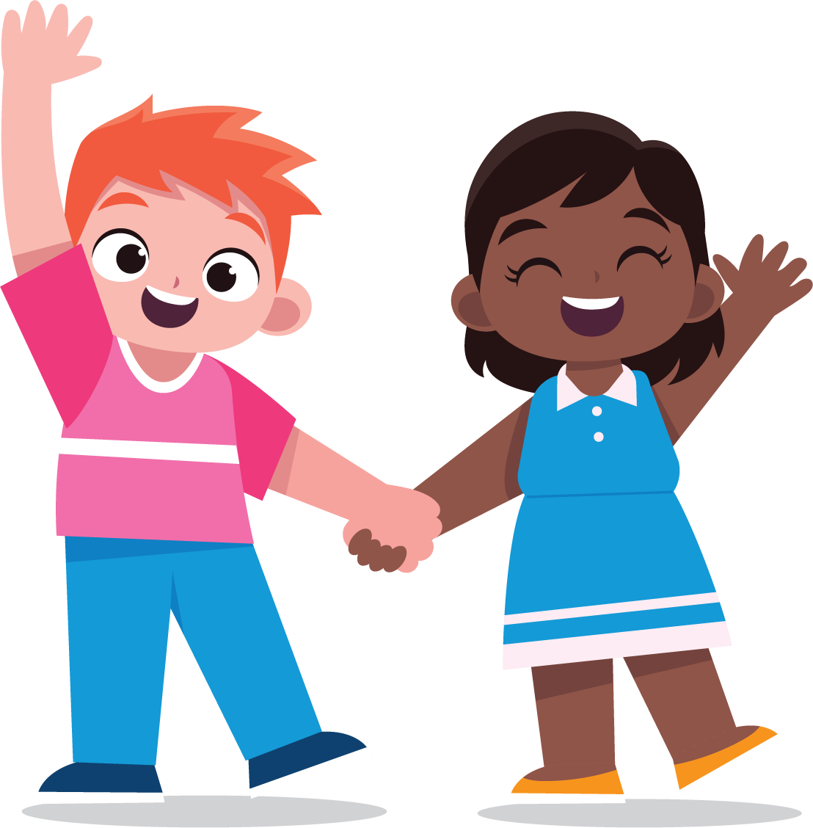
To Learn
About Identity
lausd.org/human-relations

Slide 2
Would You Rather
Be invisible
Have super strength
lausd.org/human-relations

Slide 3
What Is Identity?
Your identity is all the different parts that make you who you are.
GENDER
RELIGION
RACE
The state of being male, female or other in relation to social and cultural roles
Belief in or devotion to spiritual faith or observance
A concept used to describe a group of people who share physical characteristics such as skin color
WHO WE LOVE
IDENTITY
ABILITY
Who you are drawn to romantically and emotionally
The power or capacity to do or act physically and mentally
LANGUAGE
RACE
The system of communication used by a particular country or community
STATUS/CLASS
The length of time a person has lived.
The relative economic or social standing of someone
lausd.org/human-relations

Slide 4
Pair Share
What are some parts of your identity?
IDENTITY
lausd.org/human-relations

Slide 5
Sometimes You're A Caterpillar
lausd.org/human-relations
Notes:
https://www.youtube.com/watch?v=hRiWgx4sHGg

Slide 6
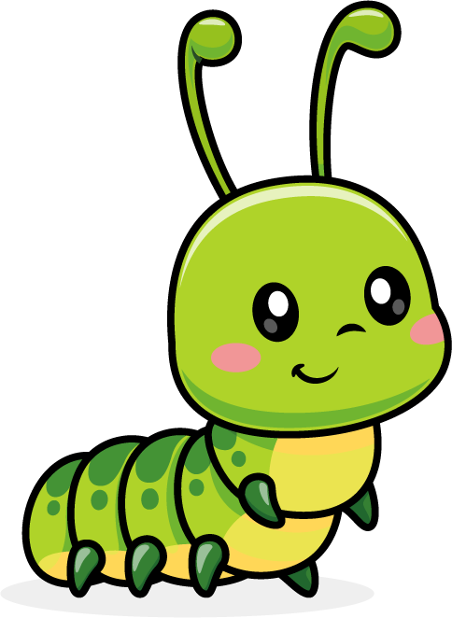
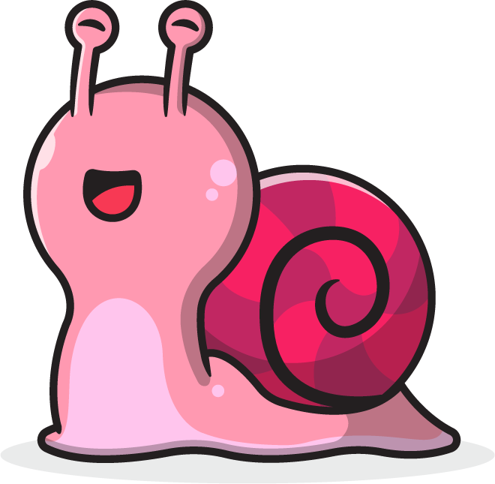
Pair Share
Share with your partner some of the unique challenges Snail had that Caterpillar didn't have.
lausd.org/human-relations

Slide 7
Pair Share
Did Snail have any unique challenges of their own?
lausd.org/human-relations

Slide 8
Identity Matters
There are many parts of our identity that we cannot change. We have no control over.
Sometimes, we get treated a certain way because of these parts of our identity.
Sometimes, we treat other people a certain way because of parts of their identity that they can't change.
lausd.org/human-relations

Slide 9
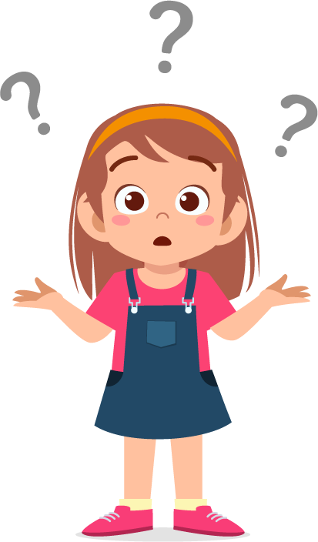
Pair Share
Have you ever felt like you've been treated differently because of a part of your identity?
How did that feel?
lausd.org/human-relations

Slide 10
Our Identities Make us Unique!
It is OK to notice other people's identities.
It is GREAT to celebrate the similarities and differences between people.
It is not ok to leave someone out or treat someone different because of their identity.
lausd.org/human-relations

Slide 11
Discussion
In the video, Snail couldn't get under the fence.
Caterpillar could have left Snail behind, but didn't.
What ended up happening?
lausd.org/human-relations

Slide 12
Acknowledge Identities & Problem Solve
Caterpillar could have left Snail behind, but didn't!
Once Caterpillar acknowledged that Snail's identity made it harder to Snail to go under the fence, Caterpillar and Snail worked together to overcome the barriers and problem solve.
lausd.org/human-relations

Slide 13
Make a Choice!
Making a choice to learn about your identity is important because it will help you understand different people experience the world.
Understanding that people can be treated differently because of their identities can also help you to become a better problem solver, like Snail and Caterpillar!
lausd.org/human-relations

Slide 14
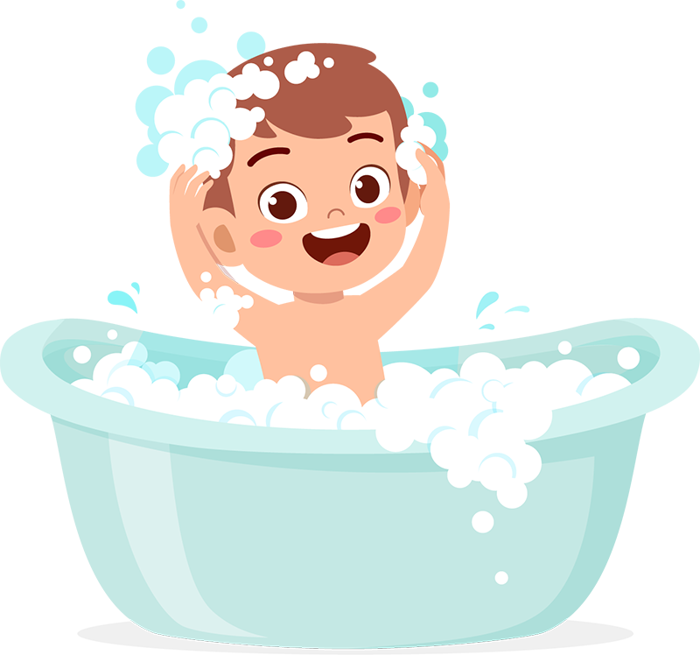
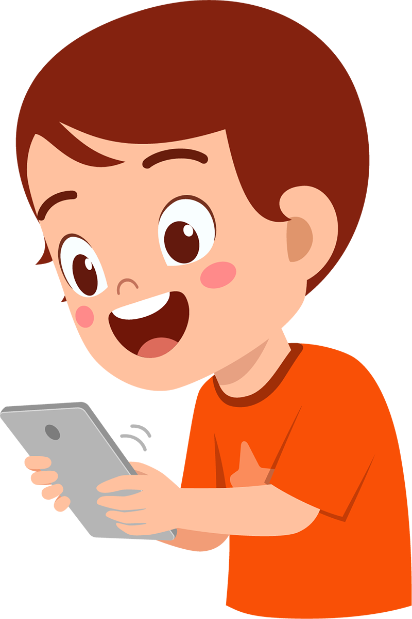
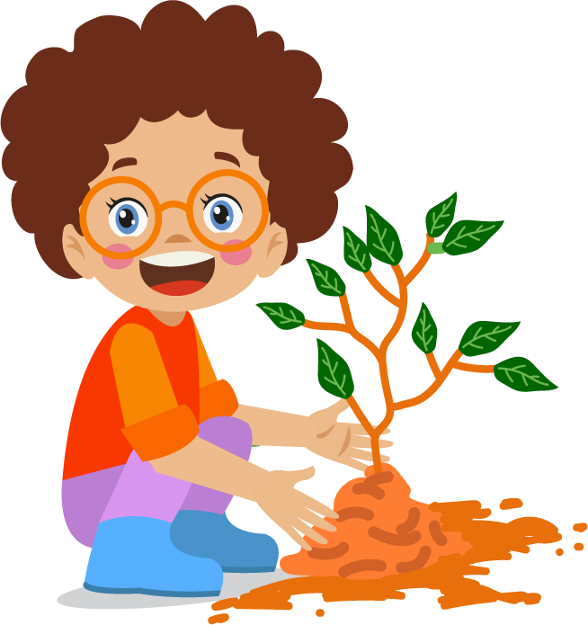
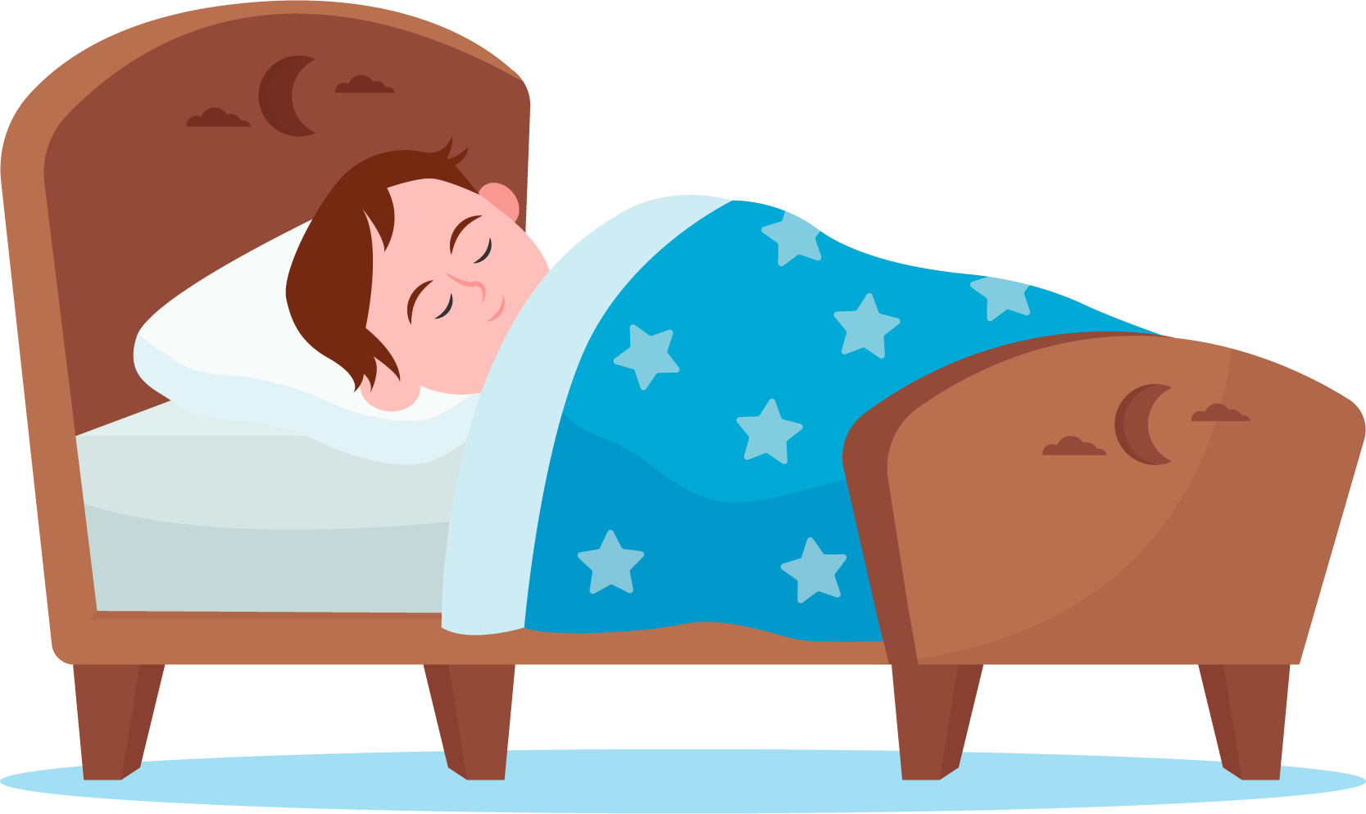
Check Out
What will you do for yourself today?
Take a bath
Listen to music
Read a book
Call a friend
Enjoy nature
Take a nap
lausd.org/human-relations

Slide 15
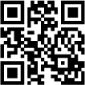
Committed to fostering a safe and respectful District, school and community culture where the seeds of peace and justice are down so that all students and staff can lead safe, purposeful and academically fruitful lives.
Connect with us at bit.ly/LAUSD-HRDE
lausd.org/human-relations

